Slide 1
Toxic Comment Detection using Explainable AI
Group no: 04
Md. Rezuwan Hassan (21266014)
Shafin Mahmud Jalal (21266017)
Rufaida Tasin (21266037)
Masum Uddin Ahmed (21273001)
S. M. Niaz Morshed (22173003)

Slide 2
Introduction
●Toxicity in the internet recently is a significant issue people face Everyday.
●Machine learning models can now predict new and unseen data but do not explain how distinct features contribute to the output.
●AI may not deliver explanations in complex scenarios.
●XAI (Explainable AI) provides explanations to many queries along with the Result.
●Explainable AI is becoming a prominent analysis area and has discovered many applications in different areas.
●Explainable AI is a set of techniques and processes that permits users
to realize and rely on the outcomes and output produced by machine learning algorithms.
●Decision reliability, and organize the data in a proper way.
●Local Interpretable Model Agnostic Explanation (LIME).
●Classic solution using Logistic regression for classification.
Presenter: Masum Uddin Ahmed | 21273001

Slide 3
Literature Review
●Classification of toxic comments is a well-known study.
●Despoina Chatzakou et al. identifying the text and network features was successful.
●Thomas Davidson et al. analyzed user comments using NLP with machine learning.
●Aditya Mahajan et al. LIME discussed to make its predictions individually understandable.
●Finale Doshi-Velez et al. studied the finest approaches for the use of these interpretable machine learning models and their applications.
●Alejandro Barredo et al. found XAI is a popular in decision-making using AI techniques.
●Arun Das et al. discovered categorization of XAI techniques and strategies on different factors are available.
●Alberto Fernandez et al. showed LIME, layer-wise relevance DeepLIFT, and propagation along with their deployment.
●Tim Miller et al. Explained XAI used now as predictive maintenance (PdM) in production and social science research.
Presenter: Masum Uddin Ahmed | 21273001

Slide 4
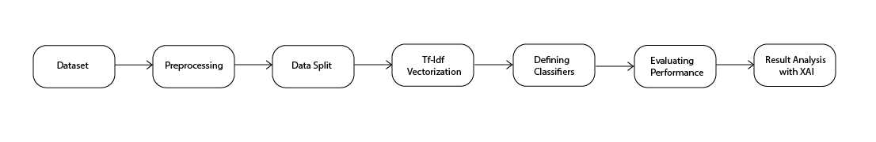
Methodology
Presenter: Rufaida Tasin | 21266037

Slide 5
Methodology
Dataset
We have collected our dataset from a Kaggle competition founded by Google and jigsaw
Includes WIkipedia comments
CSV(comma separated values) formatted dataset
Contains 159570 comments with several categories
Presenter: Rufaida Tasin | 21266037

Slide 6
Methodology
Preprocessing
Online comments are mostly non-standard english.
We have defined a function (clean_text) to clean the dataset.
A new column Toxic/Non-toxic to define if the comment falls under any of the six categories.
We have defined another function(remove_stop_words)to remove specific words.
Presenter: Rufaida Tasin | 21266037

Slide 7
Methodology
Data Split
Divided the pre processed training data into 2 sets
Training data
Testing data
Presenter: Rufaida Tasin | 21266037

Slide 8
Methodology
Presenter: Md. Rezuwan Hassan | 21266014

Slide 9
Methodology
TF-IDF vectorization
NLP tasks require effective embedding
The unsupervised weighting scheme TF-IDF to create word embeddings consisting sparse matrix.
We utilized TfidfVectorizer from sklearn library's 'feature_extraction.text' package
Presenter: Md. Rezuwan Hassan | 21266014

Slide 10
Methodology
Defining Classifiers
Multiple classifiers such as logistic regression, Bernoulli naive bayes and Linear SVC were used and all of their performances were evaluated.
Logistic regression is a statistical model that predicts binary output based on prior inspection.
We utilized the Logistic Regression from sklean library's "linear_model" package
Bernoulli Naive Bayes is one of the three variations of Naive Bayes which works well on datasets with binary values.
We utilized the BernoulliNB from sklean library's "naive\_bayes" package by setting the alpha parameter to 0.09.
The Linear Support Vector Classifier (SVC) is a type of classifier that maximize the distance between classified samples by finding a hyperplane.
We utilized the LinearSVC from sklean library's "svm" package by setting the parameter C to 1.0.
Presenter: Md. Rezuwan Hassan | 21266014

Slide 11
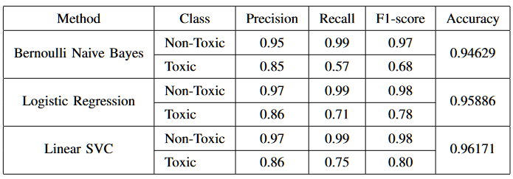
Result Analysis: Model Comparison
Model Evaluation:
Presenter: Shafin Mahmud Jalal | ID: 21266017

Slide 12
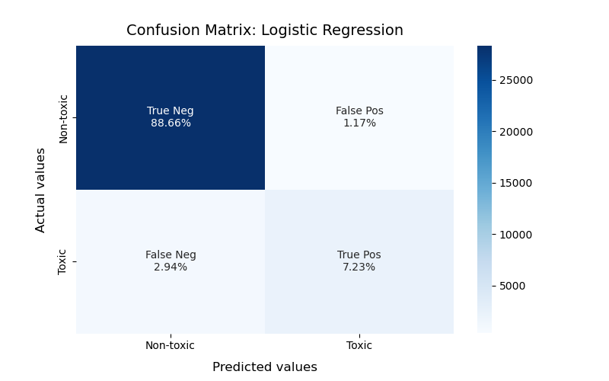
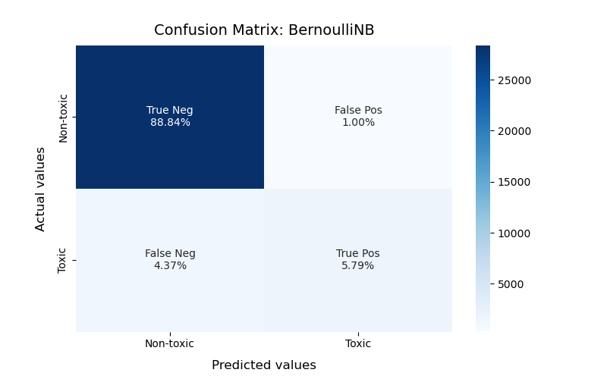

Result Analysis: Confusion Matrix
Presenter: Shafin Mahmud Jalal | ID: 21266017

Slide 13
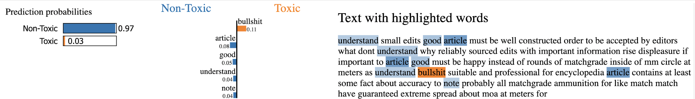
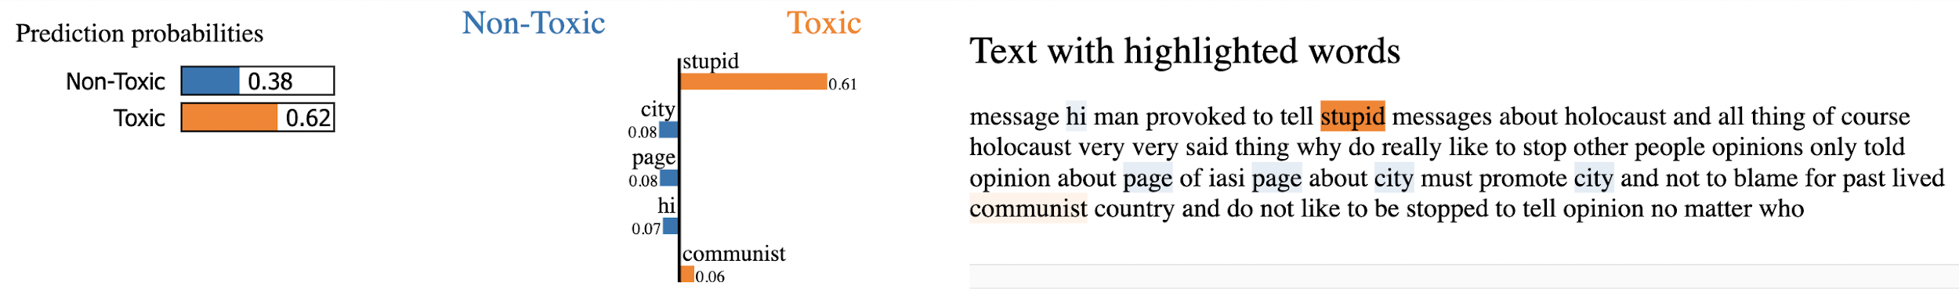
Result Analysis: XAI
Presenter: Shafin Mahmud Jalal | ID: 21266017

Slide 14
Conclusion and Future works
An Explainable AI (XAI) framework Local Interpretable Model Agnostic Explanation (LIME) was used to identify toxic comments
Matched or Outperformed other models with 96% accuracy
Explainable Artificial Intelligence implementation
Future implementation of Sentiment analysis of the toxic comments
Lackings: Real world application, Comparison with few models
Presenter: S. M. Niaz Morshed | 22173003

Slide 15
Thank You

